Slide 1
Empirical Research
2020

Slide 2

Who I am
Marco Saletta
Education: Master Degree in Physics
Previous experience: Data Scientist/Engineer since 2014 (Banzai, Mondadori, Leroy Merlin)
Currently: Data Team Leader @Facile.it
Contacts:
Work: marco.saletta@facile.it
Personal: marco.saletta@gmail.com
Linkedin: Marco Saletta
GitHub: https://github.com/SalMarco

Slide 3
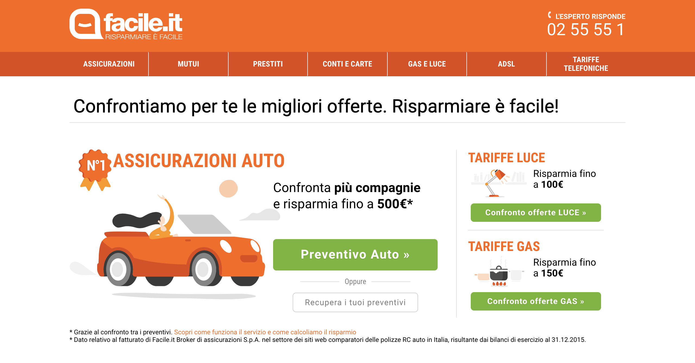

Slide 4
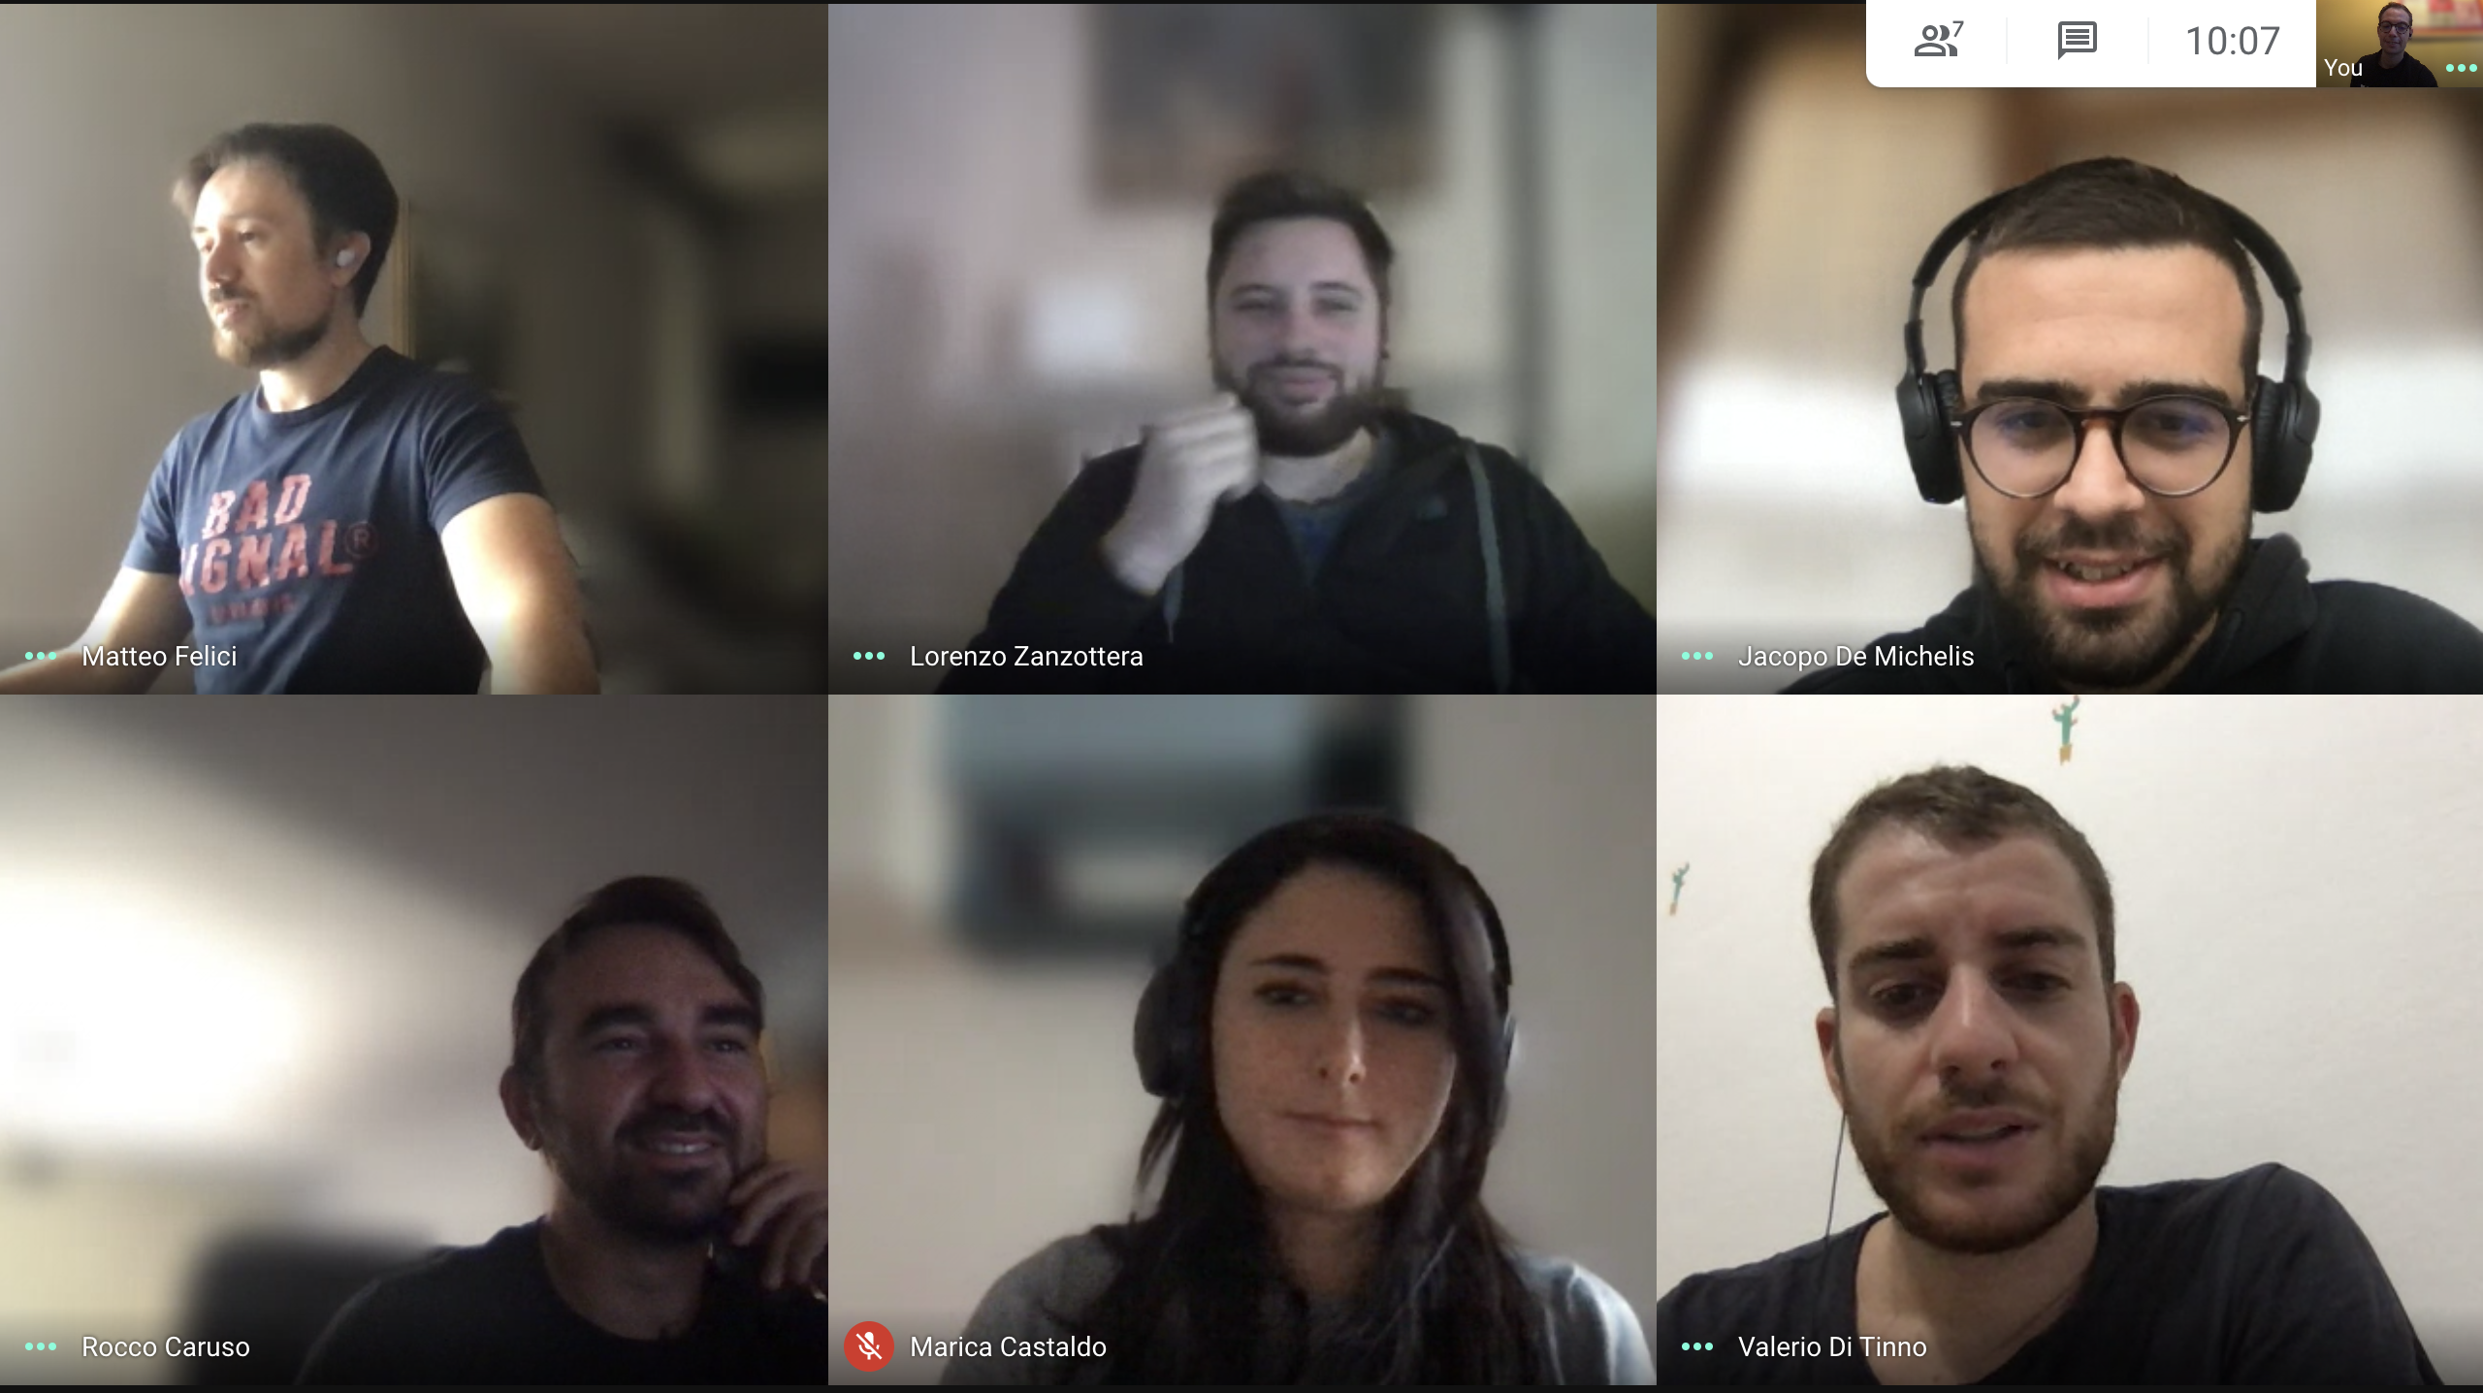
Team Data @Facile.it
At the moment we are:
3 Scientist
2 Engineer
1 Analyst
The team has grown from 3 to 7 in the last year

Slide 5
Summary
This course will be divided in 6 lessons, each one with a theoretical introduction followed by a coding session.
The arguments will be the following:
Introduction to GCP
Introduction to Python
Linear and non-linear models
Tensorflow
More in depth
...

Slide 6
Technical Information
Lessons' Repository:
For this series of lesson I'll use GitHub to store and share the materials.
There will be one repo for each lesson
The repositories will be on my GitHub page with names like https://github.com/SalMarco/Cattolica_2020_Lesson#
For all the other lessons you will need Jupyter

Slide 7
Introduction to GCP*
*Google Cloud Platform

Slide 8

What is the “Cloud”?

Slide 9
Cloud computing
According to Wikipedia:
«Cloud computing is the on-demand availability of computer system resources, especially data storage (cloud storage) and computing power, without direct active management by the user. The term is generally used to describe data centers available to many users over the Internet.^{[1]} Large clouds, predominant today, often have functions distributed over multiple locations from central servers.»

Slide 10
Cloud advantages and paradigms
Cloud main advantages:
Scalability (horizontally and vertically)
Ease of use
Security
The 3 paradigms of cloud:
IaaS
PaaS
SaaS

Slide 11
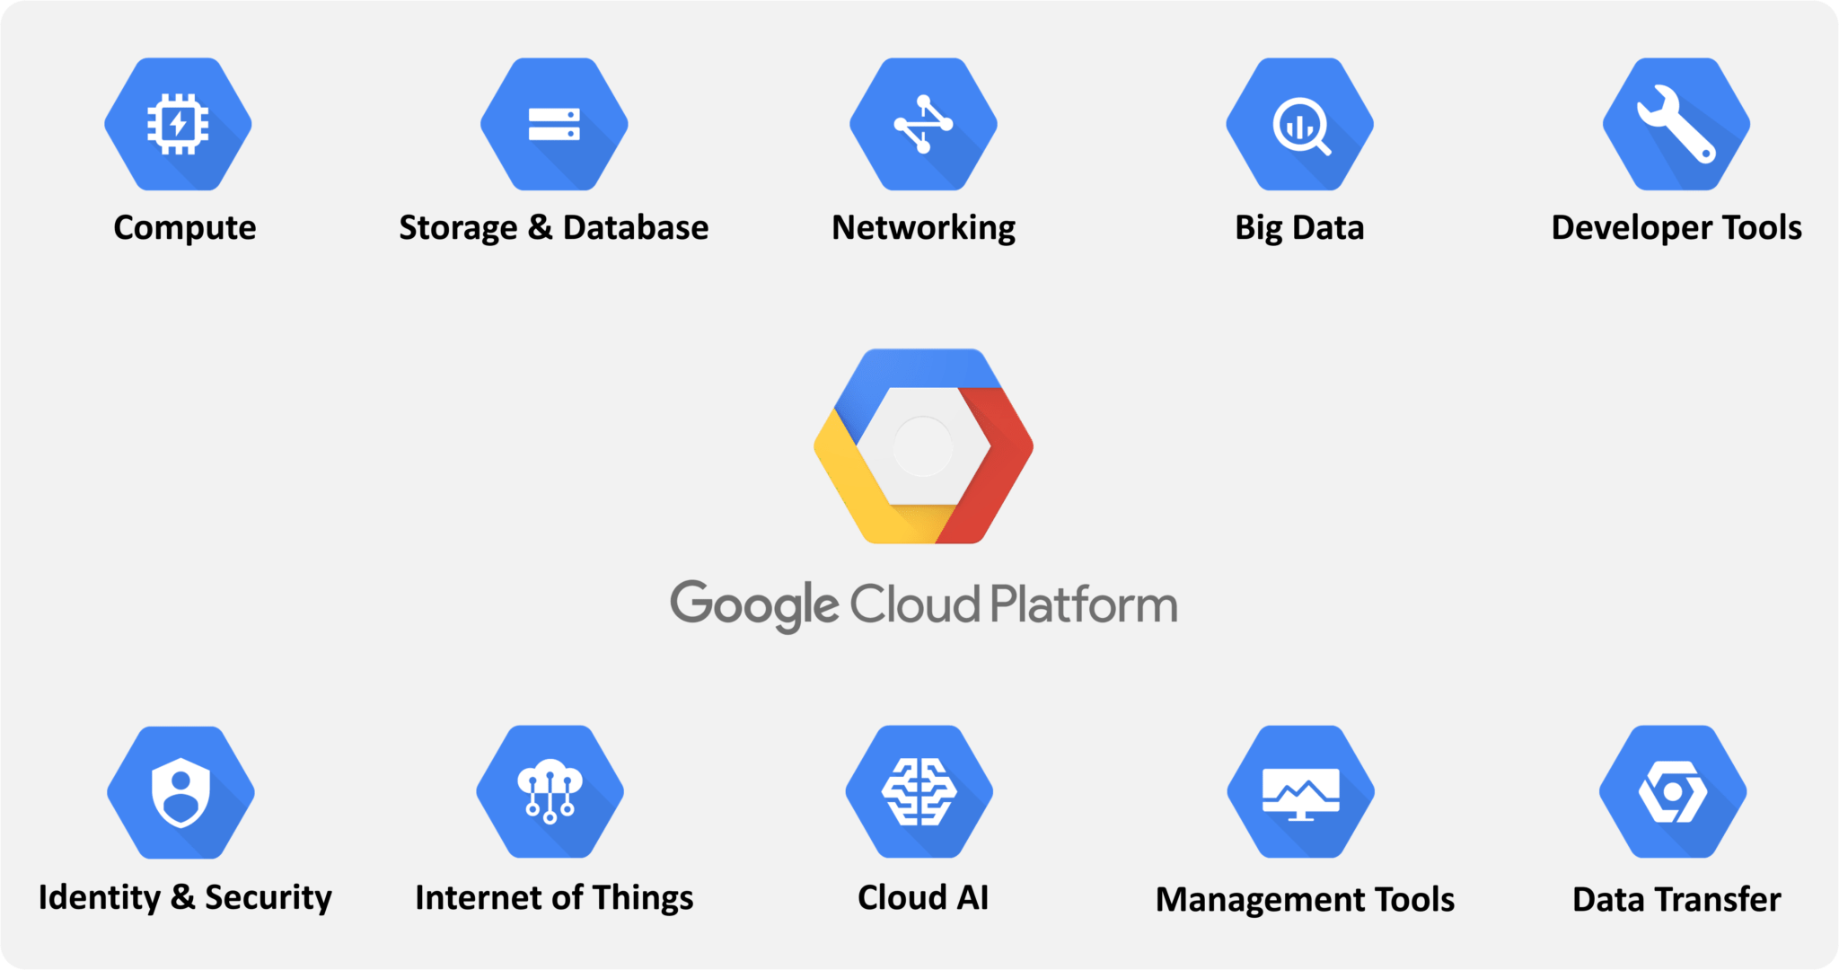

Slide 12
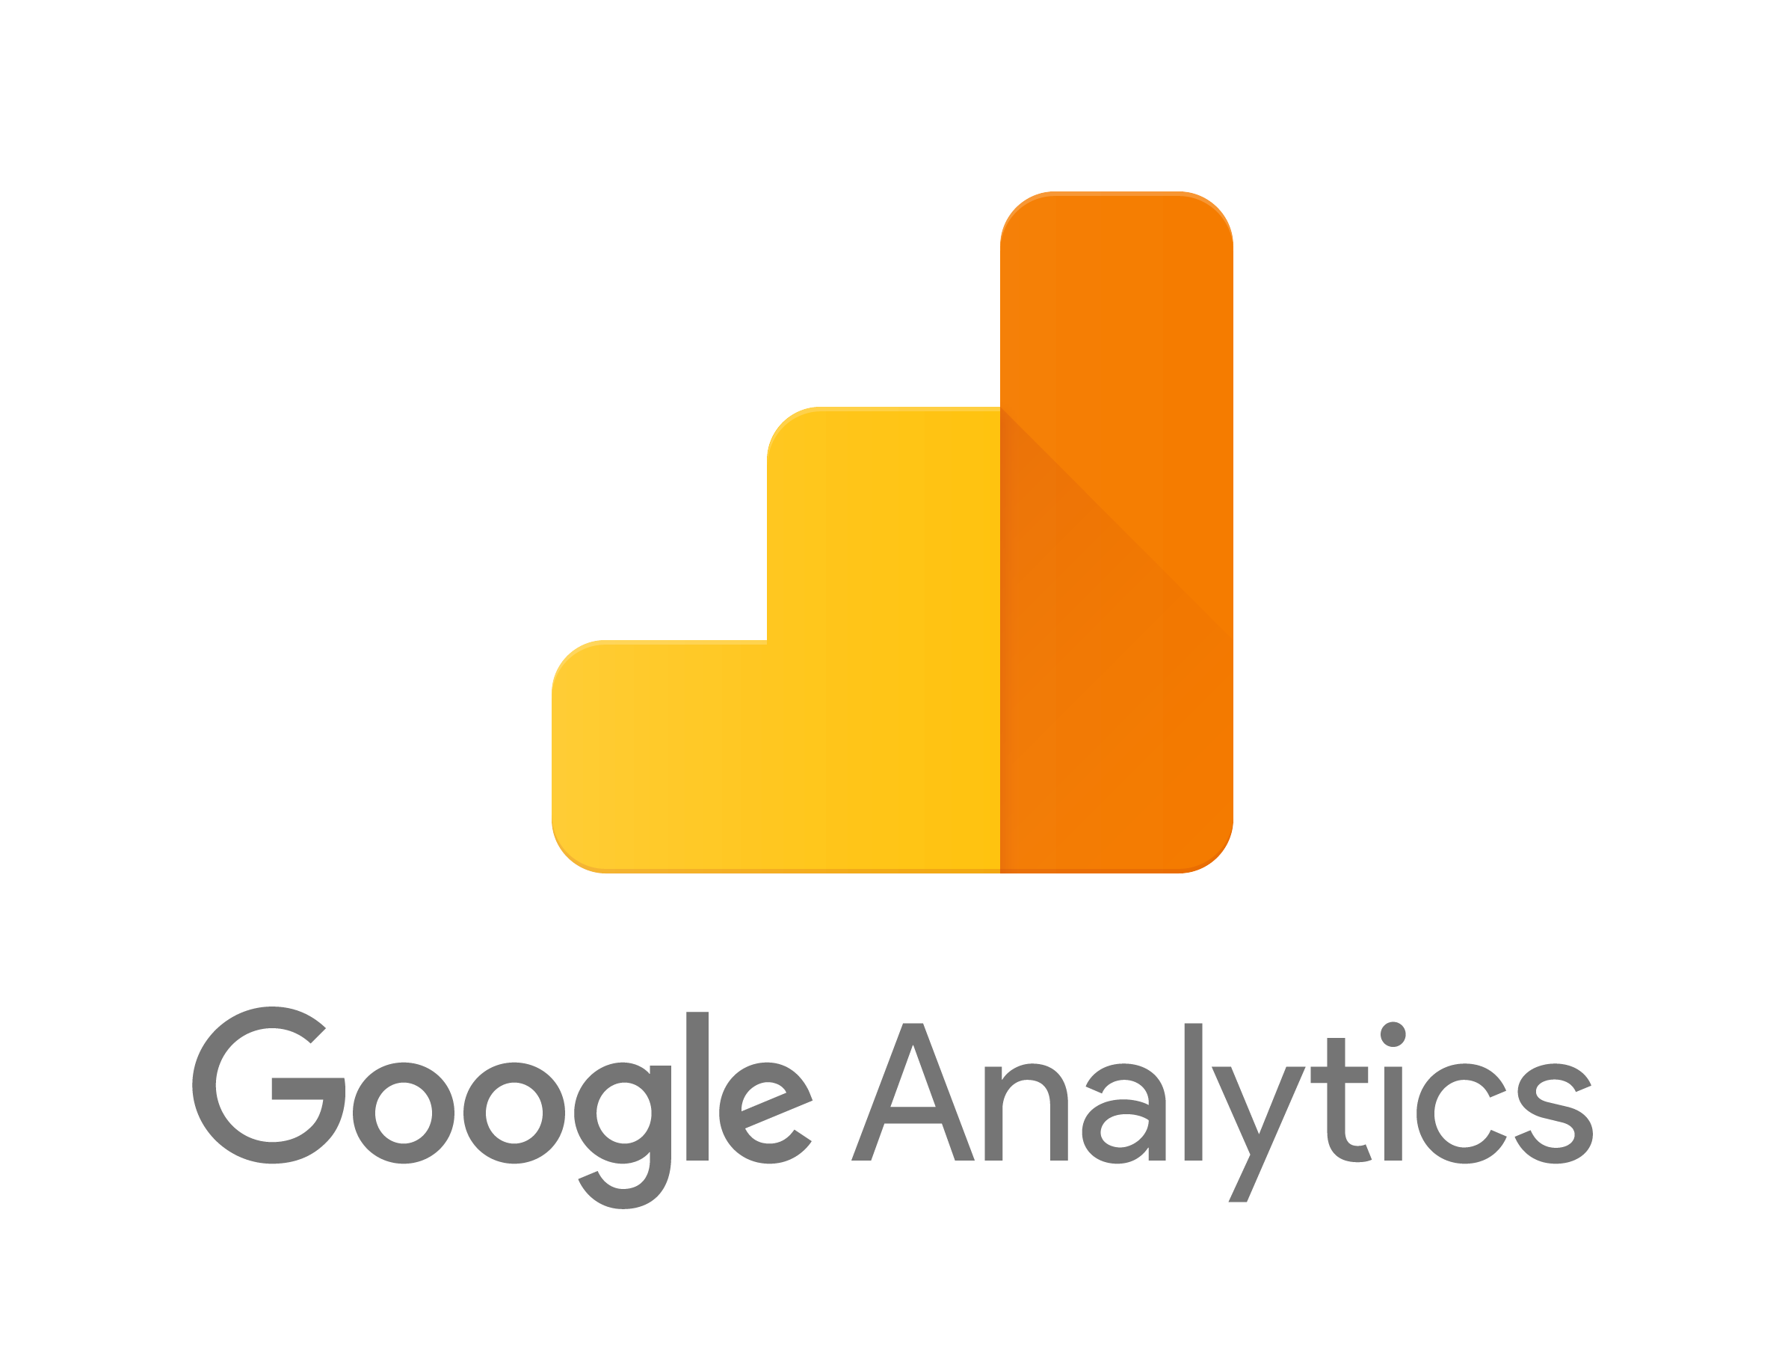












GCP @Facile.it

Slide 13
Storage: Object Storage
Low Cost
Reliability (99.95%)
Clients for many Language
Natural coiche as Data Lake

Slide 14
Cloud Functions: serverless
Low Cost
Scalability
Many Triggers

Slide 15
Pub Sub: message service
Streaming/Real Time
Events

Slide 16
Composer: orchestrator
Manged version of Airflow
Flexibility
Sensor

Slide 17
DataFlow: data processing
High level of parellization
Batch/Streaming
Apache Beam (Spark)
Natural coiche with PubSub for streaming

Slide 18
BigQuery: noSQL DB
Columnar
High performance
ML
Natural coiche as DataWarehouse

Slide 19
AIPlatform
Jupyter
Model Training
Model Serving
Pipelines

Slide 20
AppEngine: backend
Fully managed
Scalability
Flexibility

